Slide 1



NYC Taxi Ride Analysis: Predicting Tip Behavior
CHANDRALEKHA

Slide 2
What this is about?
Analyzing NYC Taxi Rides data from 2013 to understand and predict tipping behavior.
What are we trying to do?
Develop predictive models to forecast tipping patterns based on various factors.
Why is it important?
Understanding tipping behavior can optimize driver earnings and improve service strategies.
Notes:
Objective:
Predict tipping behavior using NYC taxi trip data.
Explore patterns in tipping and their relationship with trip characteristics.

Slide 3
Initial state
Size: The dataset contains approximately 170,000 taxi rides from NYC in 2013.
Format: The data is in CSV format, with structured rows and columns.
Source: The dataset is sourced from the NYC Open Data portal (https://chriswhong.com/open-data/foil_nyc_taxi/).
Columns: Key columns include fare amount, trip distance, tip amount, payment type, and trip duration.
Time period of data collection: Data was collected throughout the year 2013.
Notes:
Why This Content?
Introduces the problem and dataset concisely.
Highlights the project’s scope and relevance.

Slide 4
Data Cleaning and Transformation
Merging the Dataset
Datasets Were merged based on shared identifiers like Medallion, Hack License, Vendor ID, and Pickup Datetime to
unified trip and payment data
Fixing Dataset
Missing Data in Categorical Variables
Missing Data in Critical Numerical Features
Negative/Invalid Numeric Values
Text Inconsistencies
Invalid Passenger Count
Features Created
Tip Given
Weekend
Rush Hour
Trip Distance Bins
Date and Time
Notes:
Missing Data in Categorical Variables: Filled missing values in vendor_id and store_and_fwd_flag with "Unknown".
Missing Data in Critical Numerical Features: Dropped rows with missing values in dropoff_longitude, dropoff_latitude, and total_amount.
Negative/Invalid Numeric Values: Replaced negative values in numeric columns with NaN to review validity.
Text Inconsistencies: Standardized vendor_id and payment_type by stripping extra spaces and converting to uppercase.
Invalid Passenger Count: Removed rows with negative passenger counts and capped counts between 1 and 5.
# before completing this stage - - 173865 rows and 21 columns
# after completing this stage - 173192 rows and 26 columns
Features created:
Tip Given
Weekend
Rush Hour
Trip Distance Bins
Day Time

Slide 5
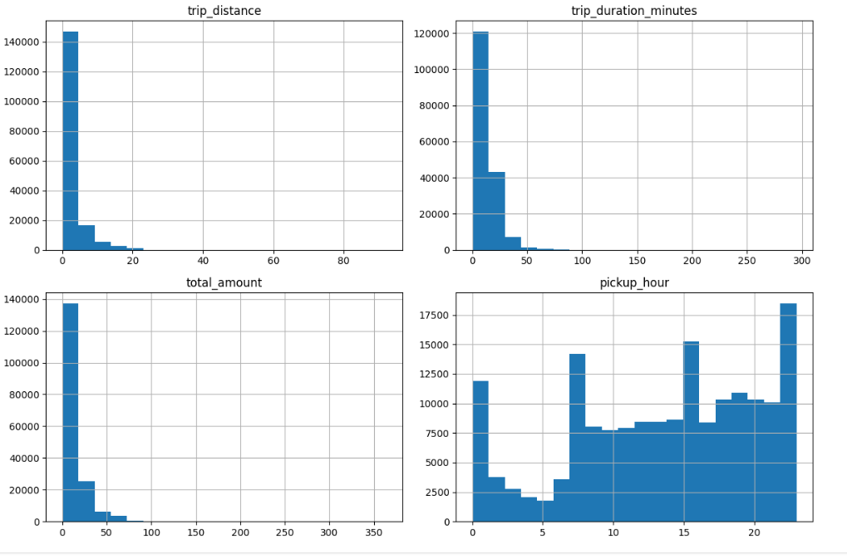
Data Analysis – Visualizing Distributions
Trip Distance Distribution:
Most trips are short (<5 miles), crucial for tipping predictions.
Trip Duration (Minutes):
Majority under 20 minutes; longer trips often mean higher tips
Trip Amount:
Most fares are <$20; higher fares tend to lead to more tips.
Pickup Hour:
Peaks at rush hours (8-9 AM, 5-6 PM), impacting tipping behavior.

Slide 6
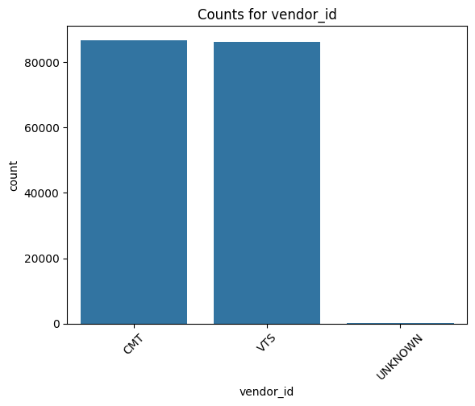
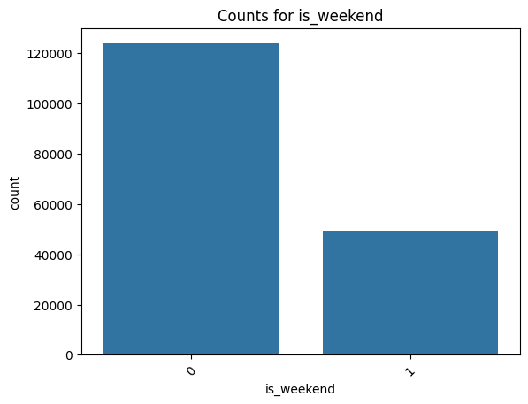
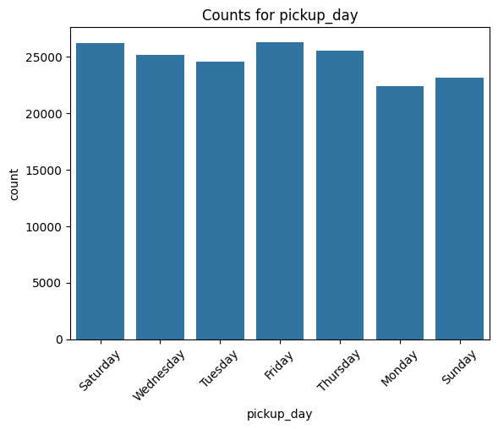
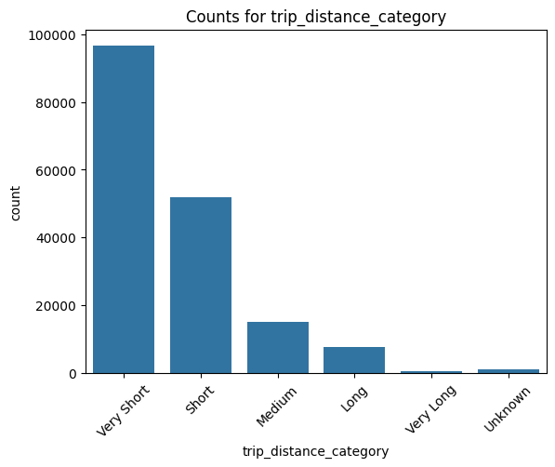
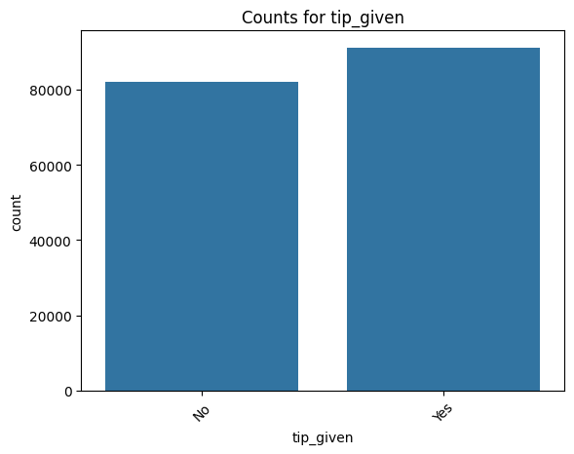
Data Analysis – Bar Plots for Categorical features
Vendor ID Distribution:
Shows counts for each vendor.
Analyzes vendor impact on tipping patterns.
Weekend Trips:
Weekend trips form a significant percentage, possibly leading
to higher tips.
Pickup Location:
Counts for each pickup location.
Highlights areas with frequent tipping
Trip Distance Category:
Categorizes trips as Short, Medium, and Long.
Shows tipping trends by trip length.
Tip Given:
Percentage of trips where tips were given.

Slide 7
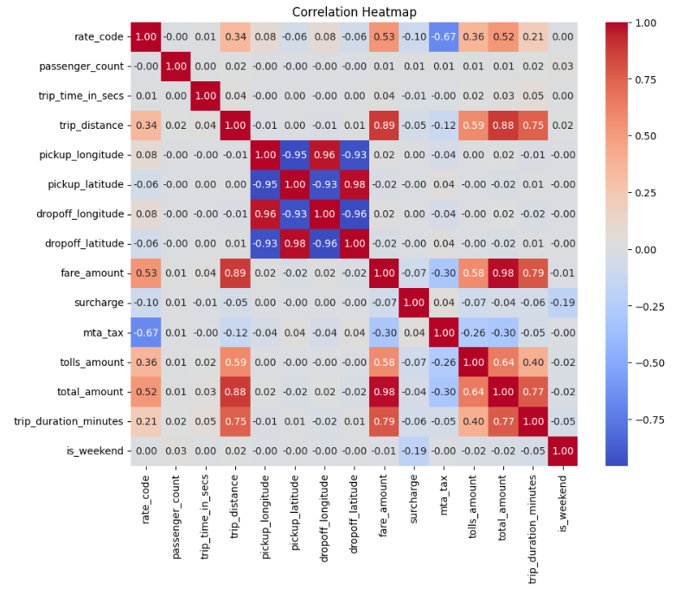
Data Analysis – Correlation Analysis
Correlation Heatmap: Heatmap of correlations between numerical features and the target variable (Tip Amount or Tip Given).
Strong positive correlations:
Fare Amount & Tip Amount: Higher fares lead to higher tips.
Trip Distance & Tip Amount: Longer trips often lead to higher tips.
Weak correlations:
Pickup Hour has minimal correlation with tipping behavior.

Slide 8
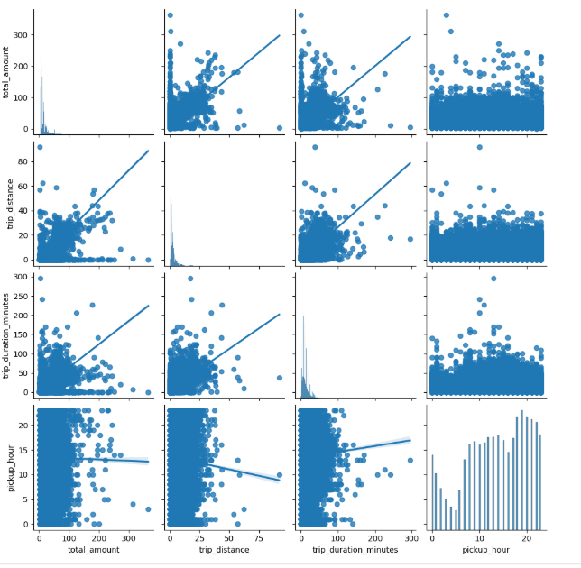
Data Analysis – Pair plots
Detailed Relationships:
Highlights relationships that influence tipping behavior, providing deeper context for feature engineering.
Fare Amount vs. Tip Amount: Higher fares result in higher tips, but tips plateau for very high fares.
Trip Distance vs. Tip Amount: Tips generally increase with distance, but variability exists for longer trips.
Other interactions between numerical features.

Slide 9
Data Analysis – Multicollinearity Check, Feature Selection
High Correlation Features:
Trip Distance and Fare Amount: Retained one to avoid redundancy.
Location Coordinates and Total Amount: Dropped due to multicollinearity and redundancy.
Feature Selection:
Key features chosen: Trip Distance, Fare Amount, Tip Amount, Payment Type, Trip Duration.
Preprocessing Steps:
Labeling: Categorical features labeled
One-Hot Encoding: Applied to Pickup Location
Missing Values: Imputed using mean/mode.
Notes:
Why This Slide?
Explains Feature Selection: Shows how multicollinearity was addressed to improve model performance.
Why This Slide?
Data Preparation: Ensures clean, well-structured data for modeling.
Transparency: Explains how raw data was transformed into a usable format.

Slide 10
Modeling
Algorithm:
We chose “Random Forest Classifier” for the baseline model because it handles non-linear relationships well, is robust to overfitting, Handles both numerical and categorical features effectively.
Features:
For the baseline model, selected features are Trip Distance, Fare Amount, Payment Type, Trip Duration
Target Variable:
Binary Target: Whether a tip was given or not (e.g., tip > $0 = 1, no tip = 0).
Metrics:
For binary classification, we commonly use Accuracy, Precision, Recall, F1 Score and AUC
Pipeline Process:
Data → Feature Selection → Model Training → Model Evaluation.
Notes:
Which Features?
For the baseline model, you would likely select features that are:
Trip Distance: A reasonable predictor of fare and, consequently, tip amount.
Fare Amount: Strongly related to the tip amount, as larger fares often lead to larger tips.
Payment Type: Some payment methods (like credit cards) may correlate with higher tips.
Trip Duration: Longer trips might generate higher tips due to increased fare.
Accuracy provides an overall measure of correctness.
Precision and Recall focus on tipping prediction.
F1 Score balances precision and recall for imbalanced datasets.
AUC-ROC evaluates the model across threshold levels.

Slide 11
Model Performance
Key Results:
Random Forest Metrics
Confusion Matrix: Our model predicted 15926 True Positives (TP) and 18102 True Negatives (TN). So, out of 34,639 attempts, our model got 34,028 correct.
Accuracy: 98.24%
Precision: 96.92%
Recall: 99.80%
F1 Score: 98.34%
Area Under the Curve(AUC-ROC): 98.15
Insights:
Balanced performance across metrics.
Indicates effective prediction of tipping behavior.
Notes:
Accuracy: 98.24% (high prediction correctness).
Precision: 96.92% (reduced false positives).
Recall: 99.80% (captured almost all positives).
F1 Score: 98.34% (balance between precision and recall).
AUC-ROC: 98.15% (excellent discrimination ability).

Slide 12
Model Improvement (Tuning)
How did you try improving your model?
We improved the model by adjusting features, tuning hyperparameters, and using cross-validation to enhance generalization.
Which other algorithms did you try and why?
We did not try other algorithms like Gradient Boosting in this case, as the focus was on improving the baseline model through hyperparameter tuning and cross-validation.
Which other hyperparameters did you tune?
We tuned max depth, number of estimators, min samples leaf, and min samples split to optimize performance.
Did you use Cross-validation and GridSearch?
Yes, we used cross-validation for robust evaluation and GridSearchCV to identify the best hyperparameter combinations.
How did you compare the models' performance?
We compared models using accuracy, precision, recall, F1 score, and AUC(ROC).
Which model performed the best?
The improved model performed the best, with an AUC of 98.55% (up from 98.16% in the baseline). It also showed better recall (99.97% vs. 99.81%) and a slight increase in accuracy (98.29% vs. 98.23%), making it the superior model.
Notes:
Why This Slide?
Showcases the effort put into refining the model.
Explains why Gradient Boosting outperformed others in predictive accuracy and stability.

Slide 13


Conclusion
Tipping behaviour was predicted using NYC taxi trip data with the random forest model, enhanced through grid search and cross-validation.
key features included fare amount, trip distance, trip duration minutes, and payment type.
challenges: imbalanced data, multicollinearity ,high computational cost.
future work: add driver ratings and passenger demographics. Explore real-time systems.

